Slide 1
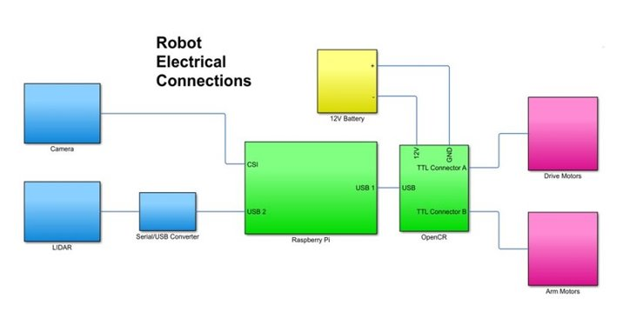
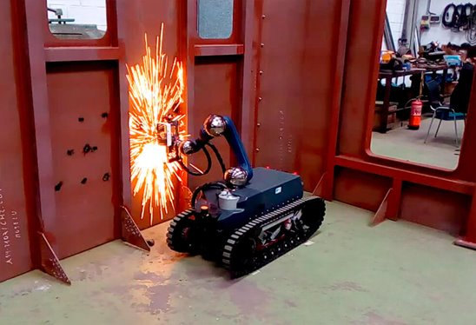
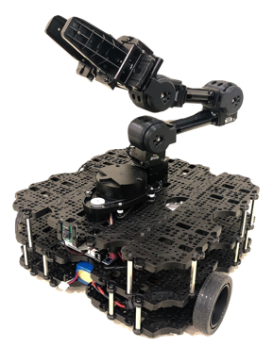
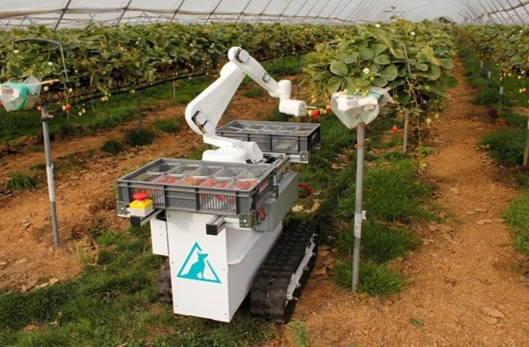
General Purpose Mobile Manipulator
#1
Materials & Implementation Process
Department of Electrical Engineering and Computer Science
For this project, the team used the Robotis Turtlebot3 WafflePi, Open Manipulator, and a remote Ubuntu PC. The raspberry Pi 3B+ used ROS Kinetic while the PC used ROS Melodic. In order to operate the movement, a python script was implemented with a control algorithm designed in Matlab Simulink. A ROS bag was implemented and integrated in python for the manipulator movement.​
​
Team Members
Faculty Advisor
Kayla Miller​
Matthew Vohland​
Khalid Nezami​
Gabriel Gilman​
Giovanni Michel​
Dr. Hari Kalva
Problem Statement
Overview
The project is an attempt to help customers conduct repetitive tasks in a faster, more efficient, and cost-effective manner through automation and by reducing the need for manual labor. The robot we developed is general-purpose can be used for a multitude of object manipulation and movement task.
The general-purpose mobile manipulator will be able to be given various locations by the user in the ROS command line. Once the robot has been given the locations it will go to the first destination to pick up an object. It will travel to the second destination put down the object. ​
Community Impact
Mobile Manipulators can be used in a variety of industries and use cases. They can be used in farms to gather fruits and vegetables or in a construction site to place bricks in a building. The product has an advantage over purpose-specific robots in that it can be mass-produced to a level that will make it cheaper for customers.
Concluding Remarks
Overall, our robot will help customers conduct repetitive tasks in a more efficient manner by reducing the need for manual labor. Our proposed solution in the form of mobile navigation and manipulation, delivers a convenient and helpful tool that can be utilized to by employers to save on labor costs.​
Sponsored by: Xiangnan Zhong Ph.D.

